Slide 1
Imageflux: Parking Detection System using Image Processing
LUCKY GUMAFELIX
CSC 492 – Senior Design
Final Report Presentation
April 26, 2016

Slide 2
Overview
Introduction
Motivation, Goal, Contribution
Background
Computer Vision, OpenCV
System Architecture
Server – Desktop Application
Client – Android Application
Imageflux: Parking Detection System
Class Design
Algorithms / Methods
Demo
Problems Encountered
Conclusion / Future Work

Slide 3
1. Introduction
Motivation – use image processing technique for a parking detection system.
Goal – successfully detect the available parking space and reports it to the user.
Contribution – implement a parking space detection system on server-client architecture.

Slide 4
2. Background
Computer Vision – “to make useful decisions about real physical object and scenes based on the sensed images”
OpenCV – open source computer vision library used for “computational
efficiency and has strong focus on real-time applications”
System Architecture
Server – Desktop Application
Take snapshot of the parking, perform image processing, upload results to webhost server
Client – Android Application
Request results from the server, and display it to the user

Slide 5
3. Imageflux: Parking Detection System
Class Design
App.java
Create and instantiates the GUI
Contains main method to start the program
ImageProcess.java
Performs various image processing techniques on the input image

Slide 6
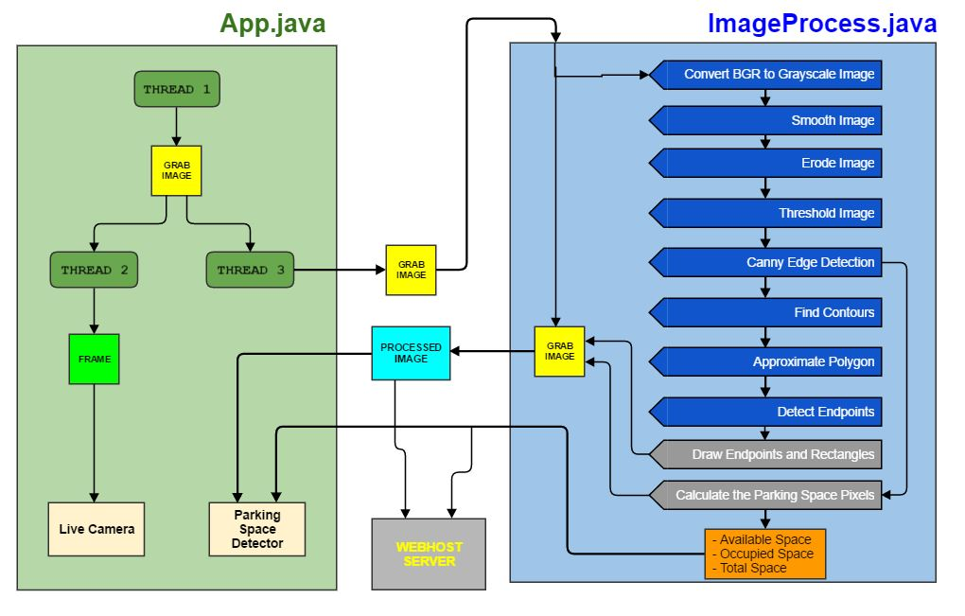

Slide 7
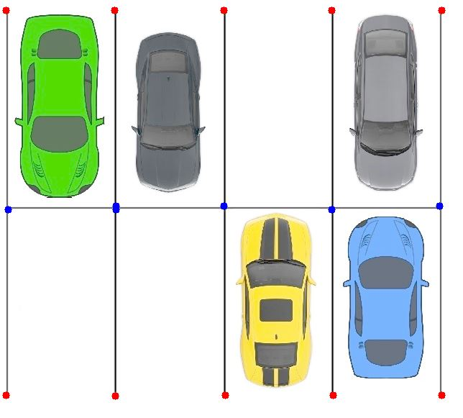
3. Imageflux: Parking Detection System
Algorithm / Methods
Figure 1.1 – Proposed method to identify
a parking space.

Slide 8
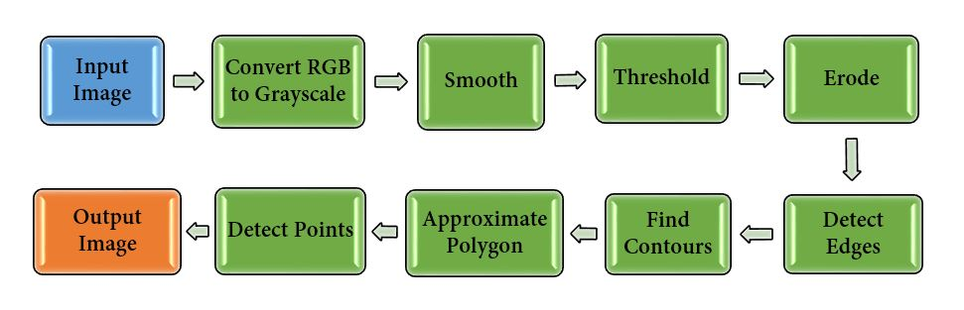
3. Imageflux: Parking Detection System
Algorithm / Methods
Figure 1.2 – Flow of algorithm process for detecting parking space endpoints

Slide 9
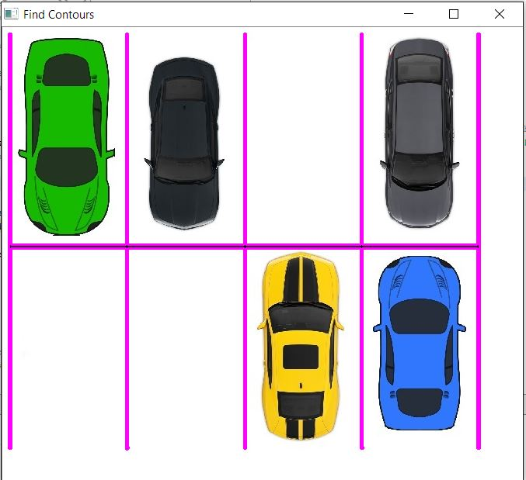
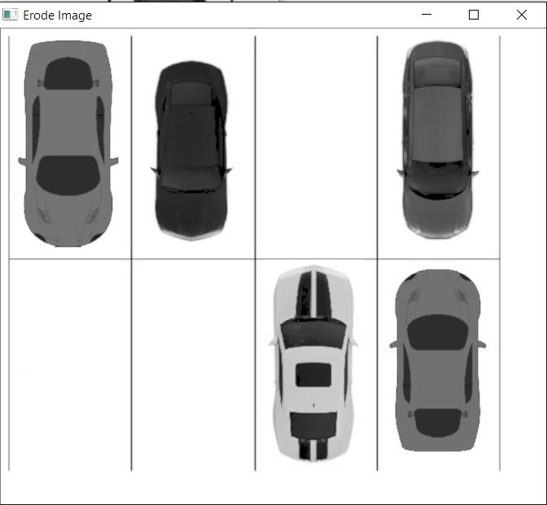
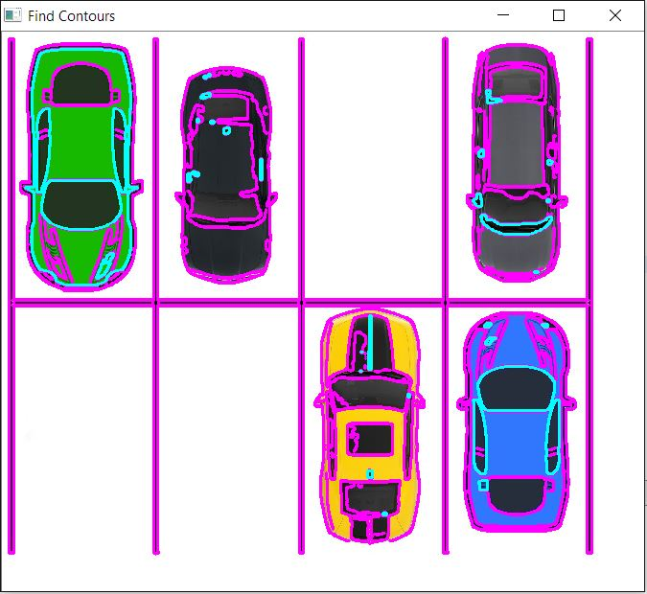
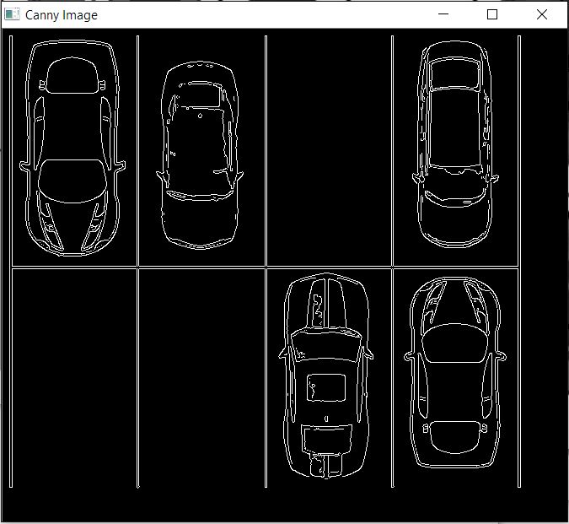
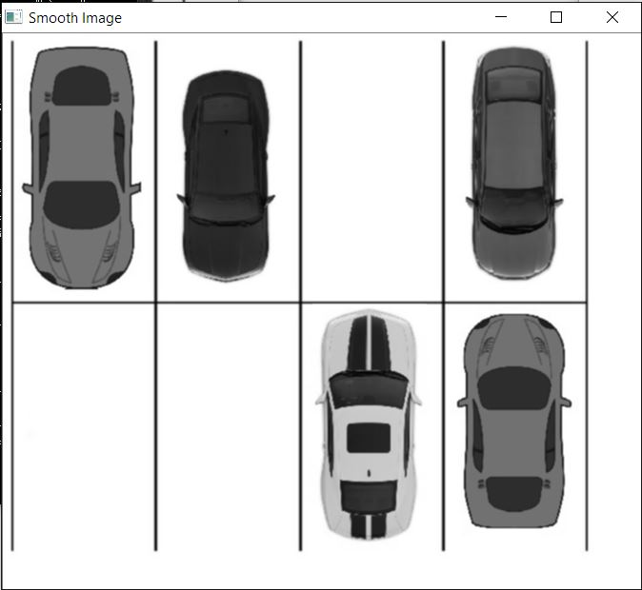
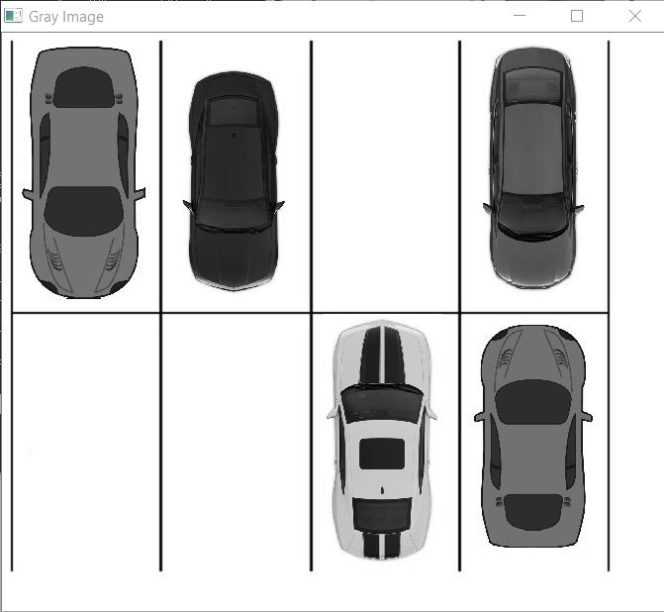
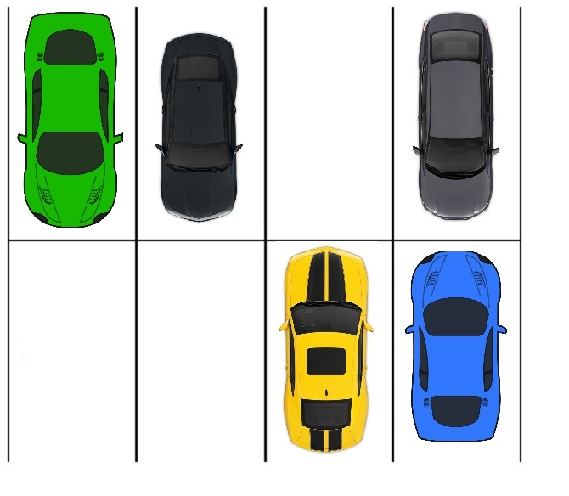
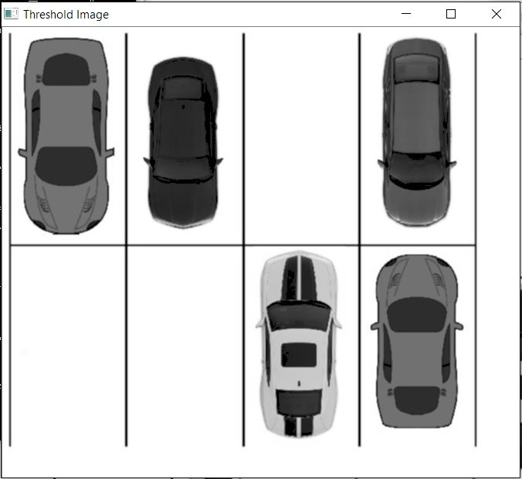

Slide 10
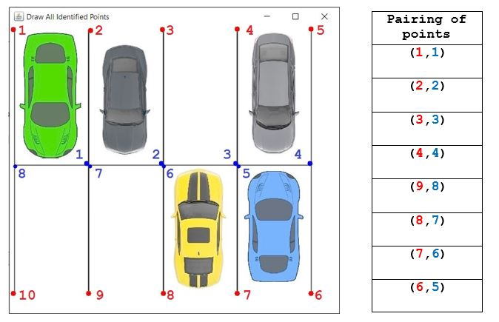
3. Imageflux: Parking Detection System
Figure 1.3 – Pairing of points to identify a parking space.

Slide 11
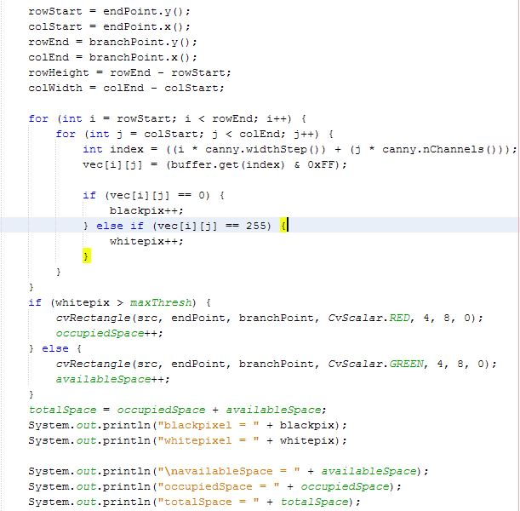
Figure 1.4 – Snippet of codes to calculate the black and white pixels per parking space.

Slide 12
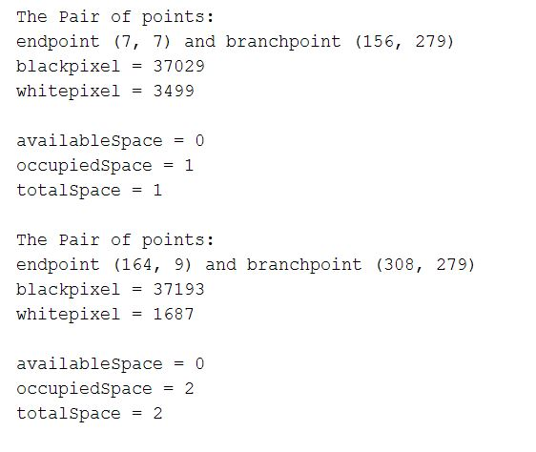
3. Imageflux: Parking Detection System
Figure 1.5 – Result of calculating black and white pixels from the Canny Image

Slide 13
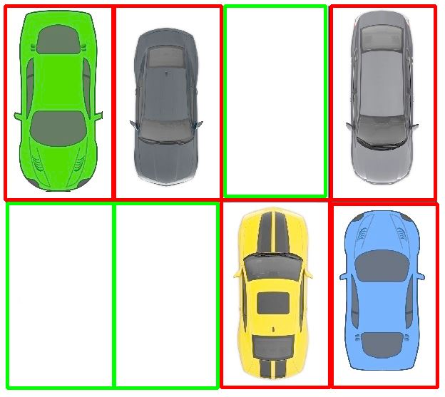
3. Imageflux: Parking Detection System
Figure 1.6 – The processed image of the Parking Detection System.

Slide 14
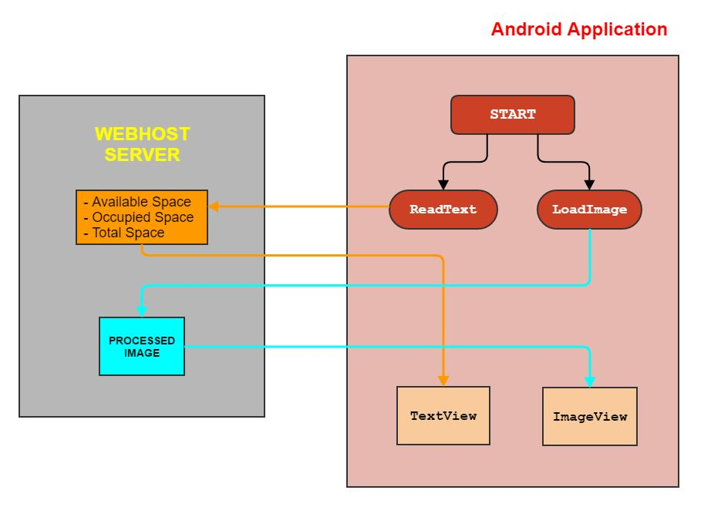
Figure 1.7 – Behind the scenes of Android application

Slide 15
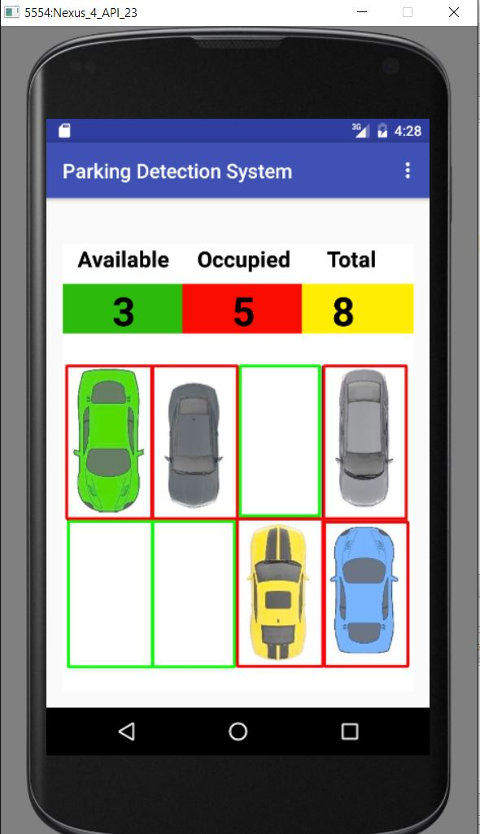
3. Imageflux: Parking Detection System
Figure 1.8 – Android emulator running the Parking Detection System.

Slide 16
3. Imageflux: Parking Detection System
< D e m o >

Slide 17
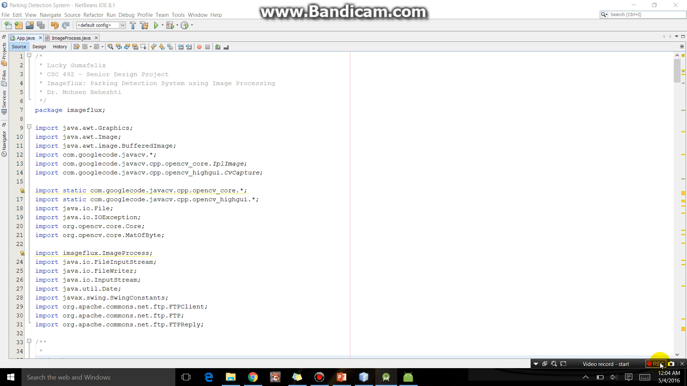

Slide 18
3. Imageflux: Parking Detection System
Problems Encountered:
OpenCV 3.1 vs OpenCV 2.4.9
Which algorithm and in what order should they be use
Testing of the system on a parking structure

Slide 19
4. Conclusion / Future Works
The implementation of Imageflux supports the conclusion that
image processing can be use for a parking detection system.
Things to improve:
Accommodate different views of the parking.
Create a light-insensitive system.

Slide 20
Parking Detection System using Image Processing
I
m
a
g
e
u
x
f
l
by: LUCKY

Slide 21


Questions? Comments? Concerns?
No cars were harmed during the demonstration of this project.

Slide 22
